Slide 1
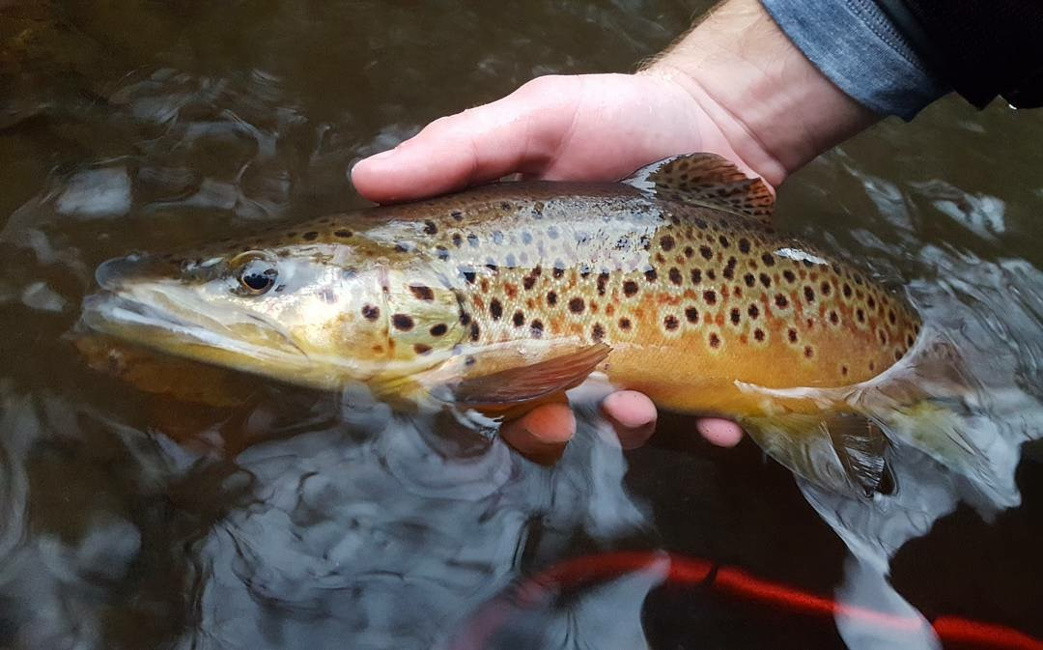
Cold Water Tactics

Slide 2
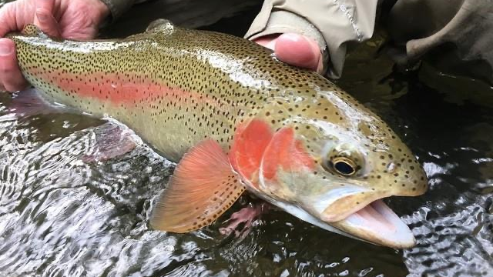
How to approach cold water fishing

Slide 3
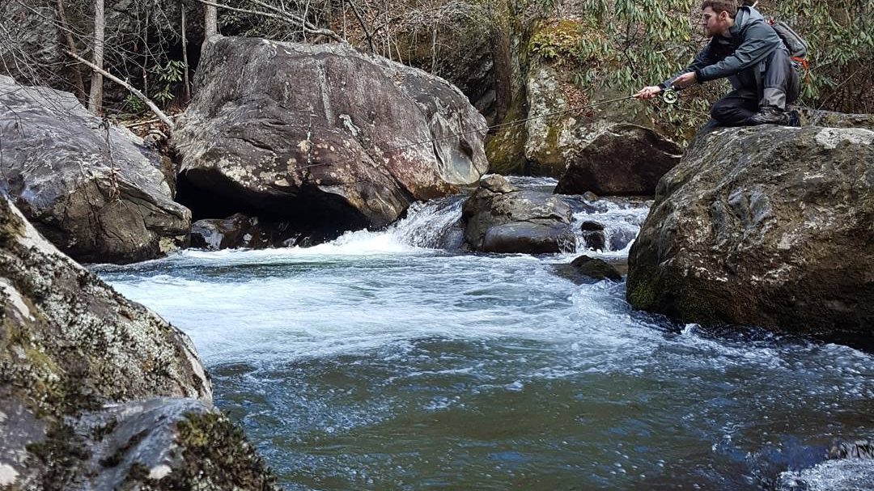
Where to fish

Slide 4
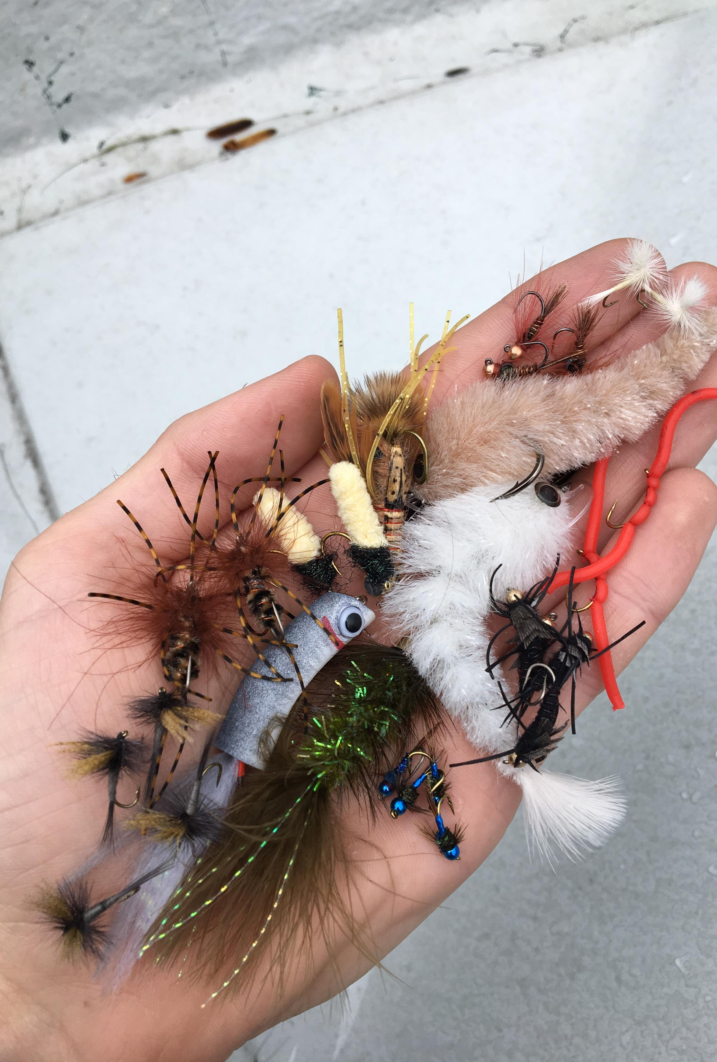
Fly selection

Slide 5
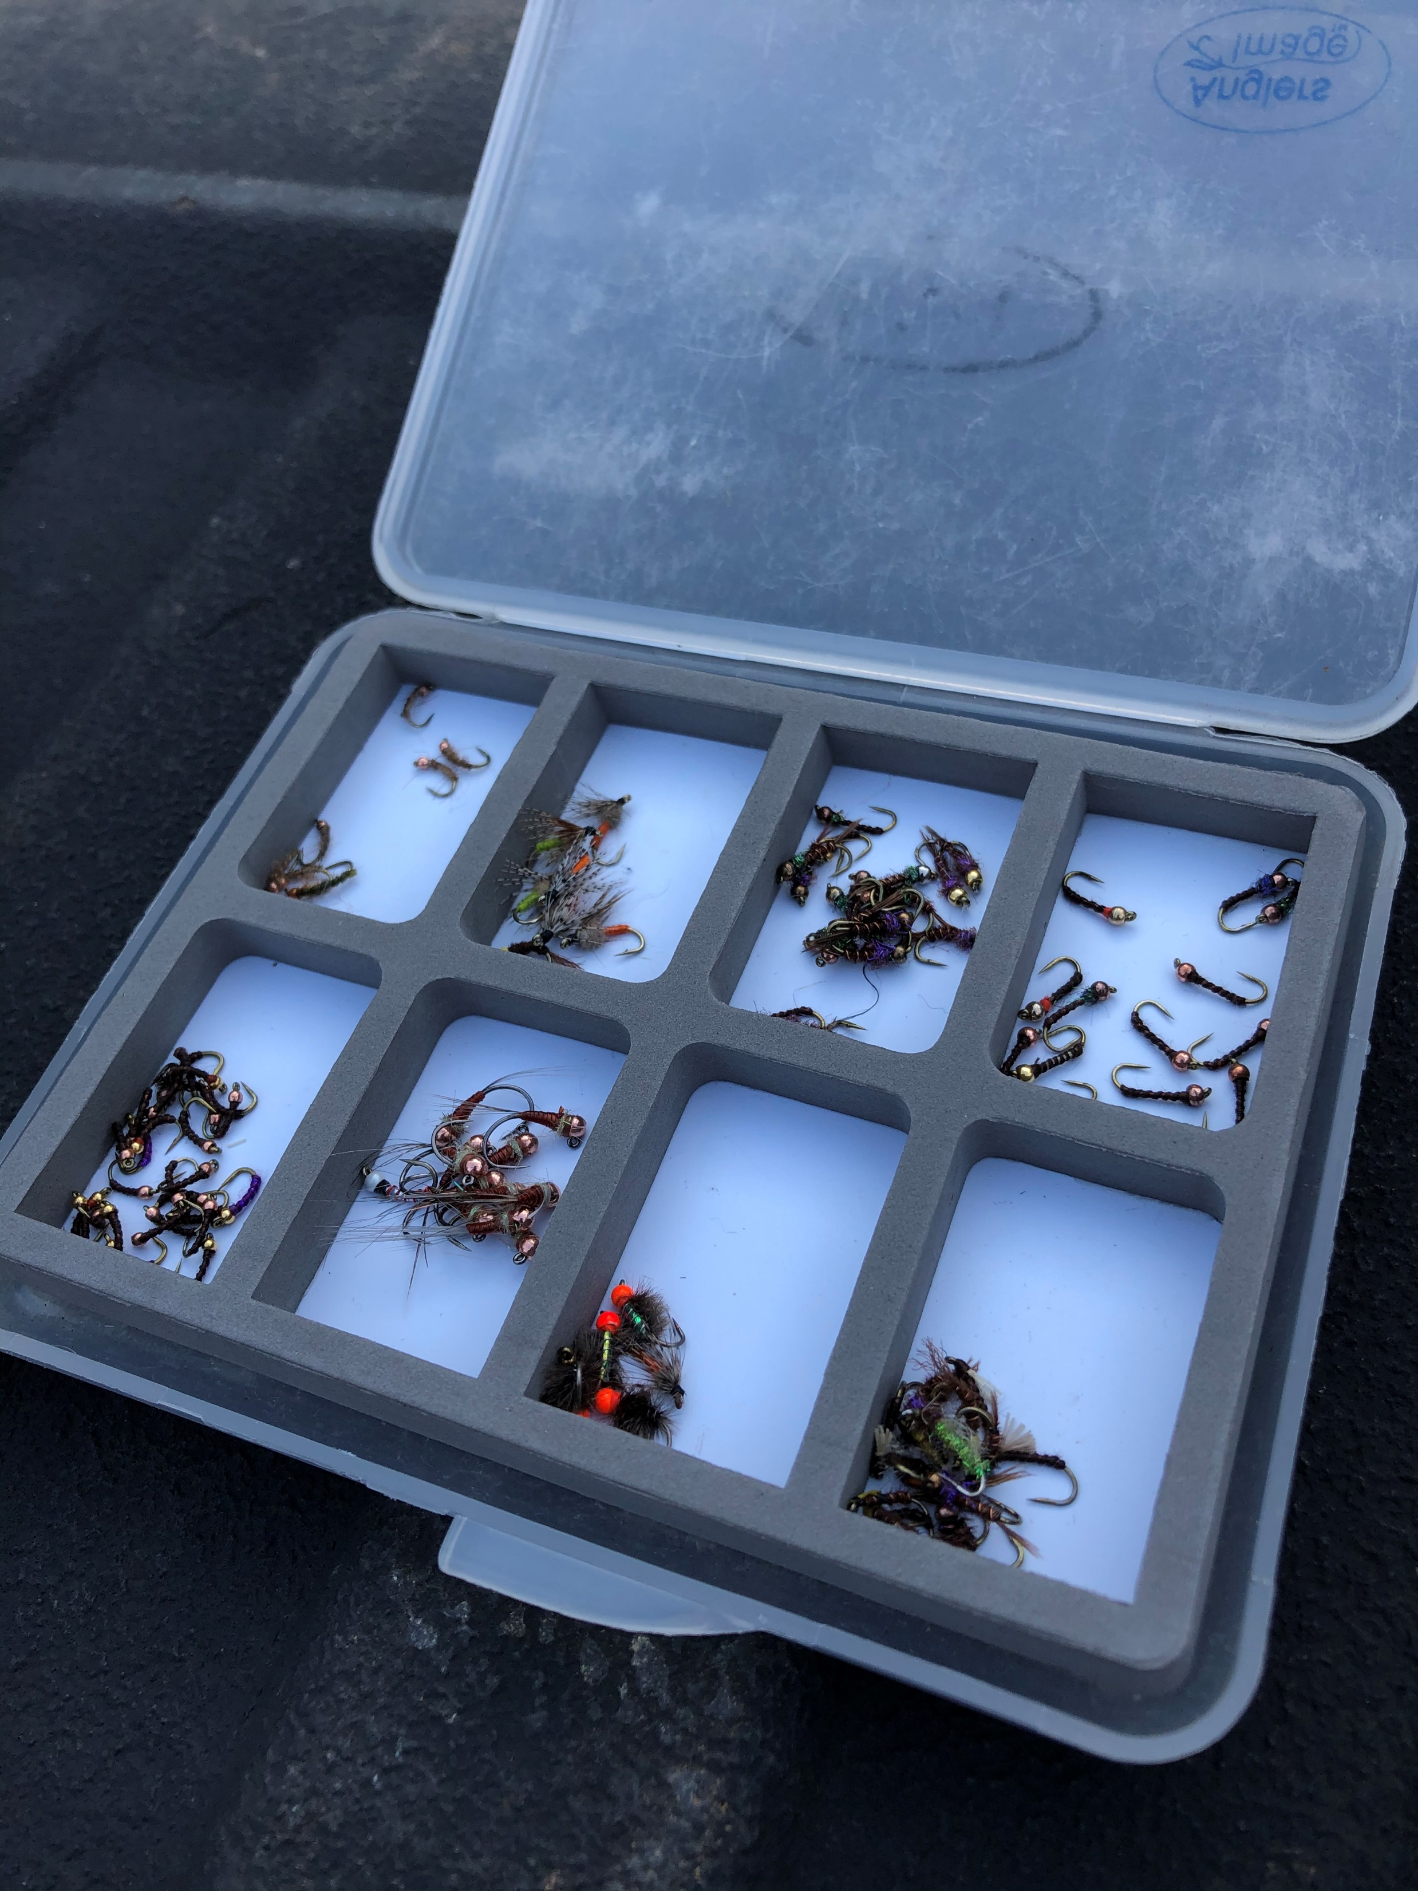
Nymphs
Root beer midge #18
Ruby Midge #18
Zebra midge #18-#22
Juju bee midge #18-#22
Rainbow Warrior #18-#22
Frenchie #14-#18
France fly #18
Little black stonefly’s #16-#18
Eggs #12-#16
Hares ear #16-#18
Pat’s rubber legs #10-#12

Slide 6
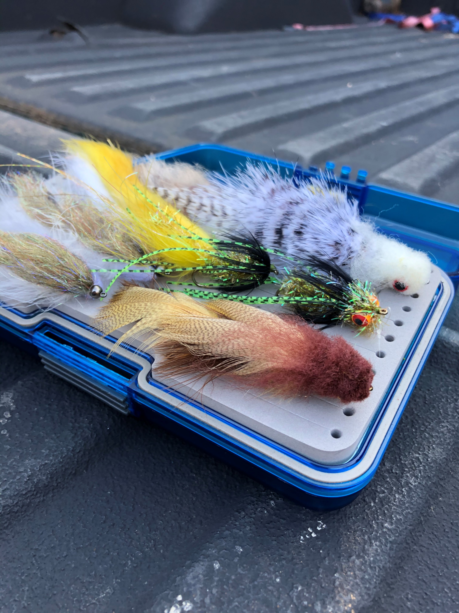
Streamers
Woolly buggers #6-#12
Sparkle Minnows #6-#8
Galloup’s Peanut Envy #4
Galloup’s Mini Dungeon #6

Slide 7
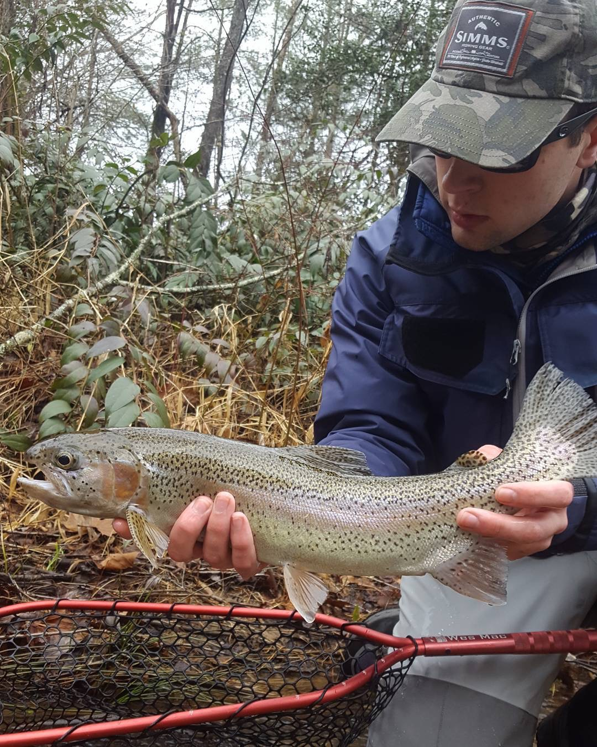
Wintertime techniques

Slide 8
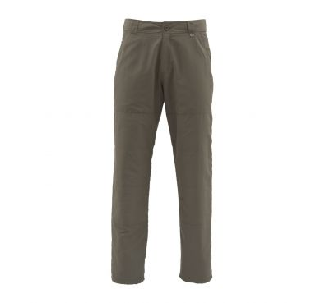
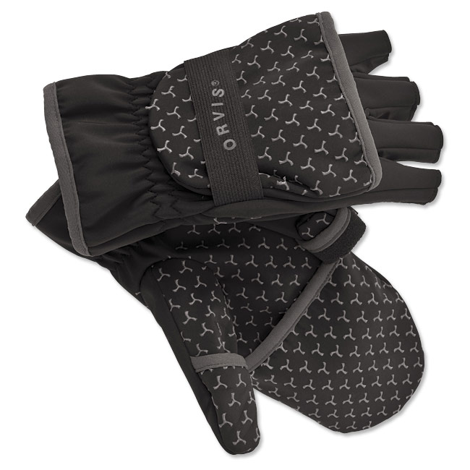
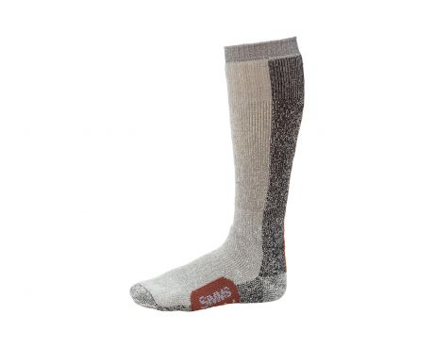
Gear to keep you warm

